Slide 1
Big Mountain Resort
Price and Feature Analysis

Slide 2
Problems and Considerations
Based on the available price and features data for the other ski resorts in its market, what is an appropriate adult weekend ticket price for Big Mountain Resort?
What future additions or reductions in features would have a positive impact on ticket price and overall profit?

Slide 3
Key Findings and Recommendations
Modeling shows target ticket price of $95.87 with MAE of $10.39
Adding run and chair lift to increase vertical drop by 150’ increases target ticket price by $1.99
Increase ticket price to $85
Evaluate cost data to see if price of adding and operating new run and chair would result in net profit

Slide 4
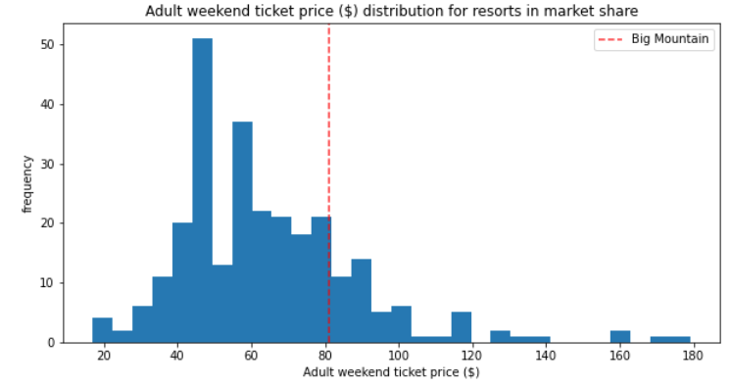
Big Mountain Resort current ticket price is $81
Modelled suggests price of $95.87
Even with the expected mean absolute error of $10.39, this suggests there is room for an increase
Distribution among market share also suggests room for price increase
Target Price Modeling for Adult Weekend Ticket

Slide 5
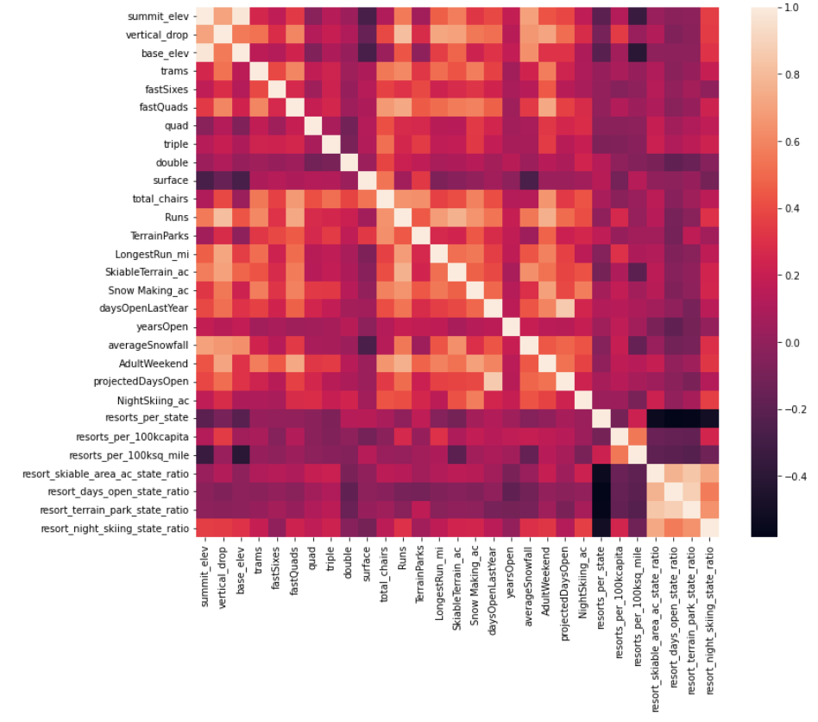
Identifying
Important
Features
Influencing
Target
Price

Slide 6
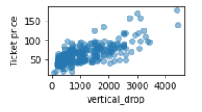
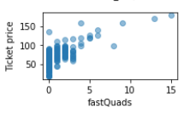
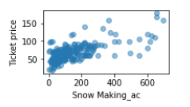
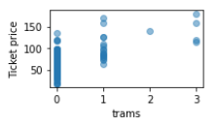
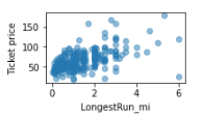
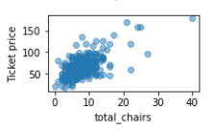
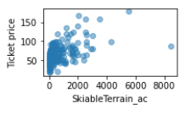
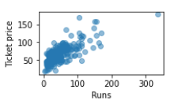
Examining correlation
between ticket price and important features

Slide 7
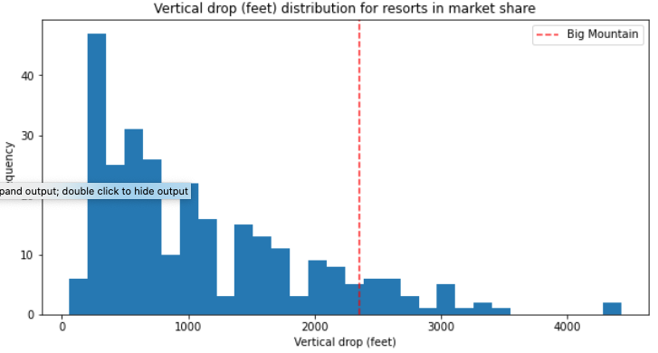
Scenario 1: Adding run and chair lift to increase vertical drop by 150’
Increases support for ticket price by $1.99
Over the season, this could be expected to amount to $3,474,638
Additional data about costs would be necessary to determine if scenario results in net profit

Slide 8
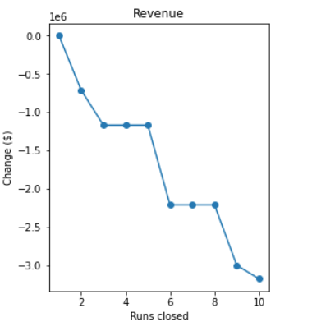
Scenario 2: Closing one or more runs
Closing 1 run: no effect on ticket price and therefore revenue
Closing 2 - 3 runs: reduces support for ticket price and therefore revenue.
Closing 3 - 5 runs: equivalent reduction in support for ticket price and therefore revenue
Closing 6+ runs: large drop in supported ticket price and therefore revenue
Additional data required regarding costs of operating the specific runs in order to determine the overall effect on profit

Slide 9
Summary
Raise ticket price to $85; consider additional price increase after the impact of the initial increase is analyzed.
Collect expense data and do further analysis to see determine the value in…
Adding a run and chair lift to increase the vertical drop by 150 feet.
Closing one or more runs

